Slide 1
Text annotator DESIGN
CSIRO GROUP 1
TR1 1 2019

Slide 2
Team contribution
Degala Anurag Yadav
Harsha Lakshmipuram
Amelia Wigg
Malayamarutrham Sai Pradmuna
Sai Gautam Mandapati
Pavani Gujjarlapudi
Eswar Sai Krishna Gowra
Tarindhu Chamara

Slide 3
Overview
The main point is to develop a web service that annotates text with definitions, taken from controlled online vocabulary services.
Make it easier, simpler and more accurate to get a definition, which has been provided by a collaboration of online vocabulary services.
A quick understanding which is enabled by hyperlinking technical terms to their corresponding definitions.
The concept of a Reference Architecture is also introduced as part of the process of creating an interoperable environment

Slide 4
Purpose
Commonly in research papers there are a set of typical words which can derive multiple meanings, easily causing confusion or misunderstanding.
This highlights the need for a tool that provides users with the assistance of hyperlinking text which can provide easy definitions or the term.
Additionally, the user can be redirected to the webpage which can assist in finding a meaning or search for terms in a field.

Slide 5
Scope
There a small number of existing tools which assist in annotating words and providing links to users and there is high demand for this type of tools, due to the complexity and array of meaning in research papers.
There are a lot of scientific terms which user may require assistance understanding or comprehending. A tool could have a range of available ontologies and therefore could be useful in a range of different fields.
Quite often technical documents have complex terminology and specific word, or phrases can denote precise definitions of some concept. In most of the cases a single term has more than one meaning.

Slide 6
System Architecture
This is about how the proposed system works. The diagram shows the architecture of proposed web application.
It consists of three main areas which are Client side, Server side and External sources.
Client side is the area which consists of GUI (Graphical User Interface) and corresponding JavaScript layer to communicate with server side.
As per the meaning of GUI, it will be the interface which can be seen from the client browser and it will be stacked with text fields, buttons etc.

Slide 7
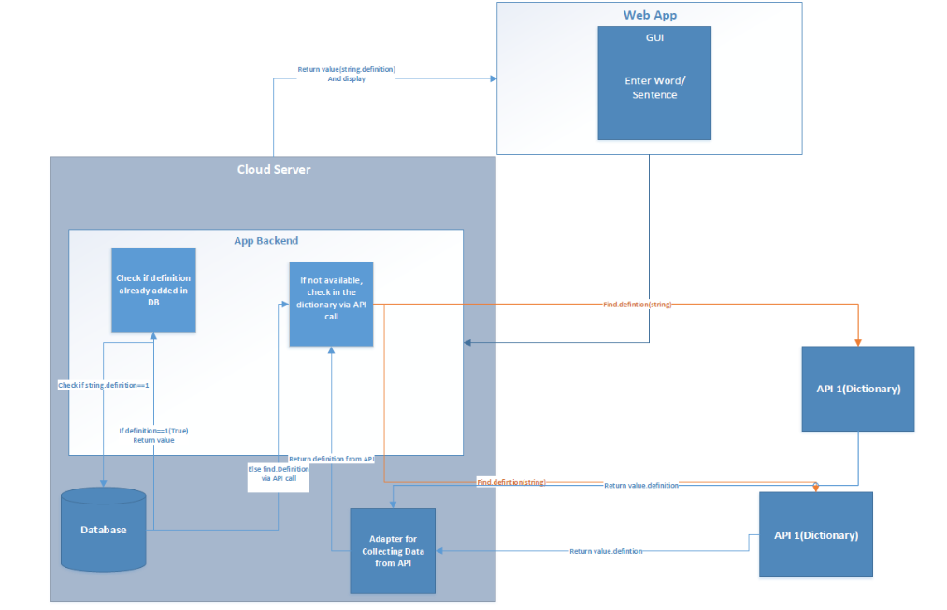
System Architecture Diagram

Slide 8
Technical Architecture
It consists of three main areas-client side, server side and external sources.
The java script layer is used for dynamic content loading or else the client page will be static and has to reload itself.
When the client ask for definition HTTP request, the java script layer in client side communicates with server side annotator.js
The annotator.js will check in the previous cached data in MongoDB whether the request is already exists.
If the request is exists it directly pulls from that if it does not exist then it connects to the external vocabularies from the server.js file.

Slide 9
Technical Architecture cont.
The response from these vocabularies is in JSON format and in order to use this format an API is built to respond and receive requests. Additionally, an external library "BodyParser" is used o handle JSON data.
The advantage of this structure is if the client wants more external resources he can design another adaptor.js class instead of changing annotator.js class or any other file.
By receiving the required result from external sources annotator.js will save it in MongoDB database for further references using MongooseJS/MongoDB plugin.
Then the annotator.js will send the HTTP response with result data to the client side JS layer which is shown in GUI dynamically.

Slide 10
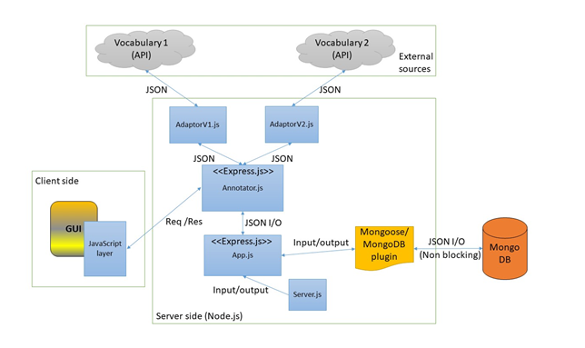
Technical Architecture Diagram

Slide 11
Infrastructure Service Overview
The following are proposed functions of the Annotator API:
Check Ontology Connection (URL, API KEY)
getAllOntologyNames()
getTextDefinitions (URL, API KEY, Text string, Ontologies, Match longest, Partial word matching, include mapping, Exclude Numbers, Exclude Synonyms)
insertToDataBase(Collection name, Data)
updateFromDataBase(Collection name, currentValues, newValues)
deleteFromDataBase(Collection name, Query Object)
searchFromDataBase(Collection name, Query Object)
getOntologyByID(Collection name, Query object)
disableExistingOntology(Collection name, Query object, currentValues, newValues)
enableExistingOntology(Collection name, Query object, currentValues, newValues)

Slide 12
1. Check Ontology Connection
Check Ontology Connection (URL, API KEY):
This function will be used to check the external vocabulary’s server status so that the GUI can show which Vocabularies are available to continue with the searching process.
This function accepts two arguments which are URL of the ontology (Vocabulary) and API KEY for the authentication purpose if it needs any.
Output of this function will be a Boolean which will be true if the

Slide 13
2. Get All Ontology Names
getAllOntologyNames():
This function will be used to find all the ontology names in order to show them in the GUI.
Output of this function will be a name collection of saved ontologies.

Slide 14
3. Get Text Definitions
getTextDefinitions (URL, API KEY, Text string, Ontologies, Match longest, Partial word matching, include mapping, Exclude Numbers, Exclude Synonyms):
a. This function will be used to find the definitions of given texts from specified ontologies.
b. The arguments for this function will be,
URL of the ontology
API KEY for authentication purposes
Text string of client’s search
Collection of client selected ontologies
Boolean value of match longest option
Boolean value of partial words match option
Boolean value of include mapping option
Boolean value of exclude numbers option
iBoolean value of exclude synonyms option
c. Output of this function will be a JSON object which includes all the definitions for the given text string from specified vocabularies.

Slide 15
4. Insert To Database
insertToDataBase(Collection name, Data):
This function will be used to store newly found results from a vocabulary search in the attached database.
This function accepts two arguments.
A name for the data collection to identifying purposes
Data that need to be stored. (JSON objects)
Output of this functions would be a success alert or an error.

Slide 16
5. Update From Database
updateFromDataBase(Collection name, currentValues, newValues):
This function will be used to update an existing data on the database.
This function accepts three arguments.
A name for the data collection to identifying purposes
Existing data that need to be updated.
New data that need to be saved instead.
Output of this functions would be a success alert or an error.

Slide 17
6. Delete From Database
deleteFromDataBase(Collection name, Query Object):
This function will be used to delete an existing record/ object is the database.
This function accepts two arguments.
A name for the data collection to identifying purposes
Query object which defines the record to delete from database.
Output of this functions would be a success alert or an error.

Slide 18
7. Search From Database
searchFromDataBase(Collection name, Query Object):
This function will be used to find previously cached data from the database.
This function accepts two arguments.
A name for the data collection to identifying purposes
Query object which defines the record to search from database.
Output of this functions would be JSON object which consists of corresponding results.

Slide 19
8. Get Ontology By ID
getOntologyByID(Collection name, Query object):
This function will be used to find a stored ontology by its ID from the database.
This function accepts two arguments.
Name for the data collection to identifying purposes.
Query object which defines the record to search from database.
Output of this functions would be JSON object which consists of corresponding results.

Slide 20
9. Disable Existing Ontology
disableExistingOntology(Collection name, Query object, currentValues, newValues):
This function will be used to disable an existing ontology from the database.
This function accepts four arguments.
A name for the data collection to identifying purposes
Query object which defines the record to search from database.
Existing data that need to be updated.
New data that need to be saved instead.
Output of this functions would be a success alert or an error.

Slide 21
10. Enable Existing Ontology
enableExistingOntology(Collection name, Query object, currentValues, newValues):
This function will be used to enable an existing ontology from the database.
This function accepts four arguments.
A name for the data collection to identifying purposes
Query object which defines the record to search from database.
Existing data that need to be updated.
New data that need to be saved instead.
Output of this functions would be a success alert or an error.

Slide 22
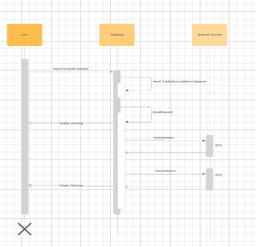
Sequence Diagram

Slide 23
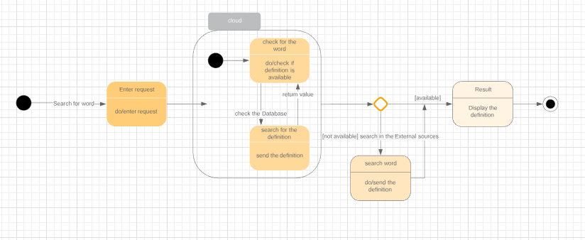
Activity Diagram

Slide 24
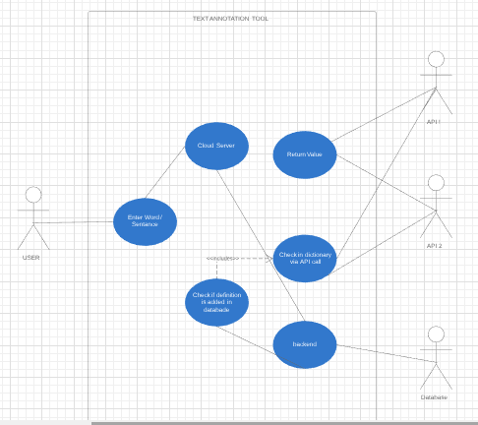
Use Case Diagram

Slide 25
Proposed Technologies
This text annotating web application will be developed by using following technologies:
HTML/ CSS
Bootstrap
HTTP/HTTPS
JavaScript/ Node.JS (JavaScript runtime)
Express.JS (Web application platform)
MongoDB (NoSQL database repository)

Slide 26
References
Bioportal.bioontology.org. (2019). Welcome to the NCBO BioPortal | NCBO BioPortal. [online] Available at: https://bioportal.bioontology.org/ [Accessed 5 May 2019].
Medium. (2019). Announcing LightTag — The easy way to Annotate text. [online] Available at: https://medium.com/@TalPerry/announcing-lighttag-the-easy-way-to-annotate-text-afb7493a49b8 [Accessed 6 May 2019].
"AI-enabled Text Annotation Tool | PDF, Markdown, CSV, html, tweets, & many more types of Documents", Tagtog.net, 2019. [Online]. Available: https://www.tagtog.net/. [Accessed: 08- Apr- 2019].
Social Annotations, Highlighting and Social Bookmarking, retrieved 4 July 2006, <https://www.diigo.com/>

